Slide 1
Lead Change With Confidence
<Name>, <Title>
<Enter Date>

Slide 2
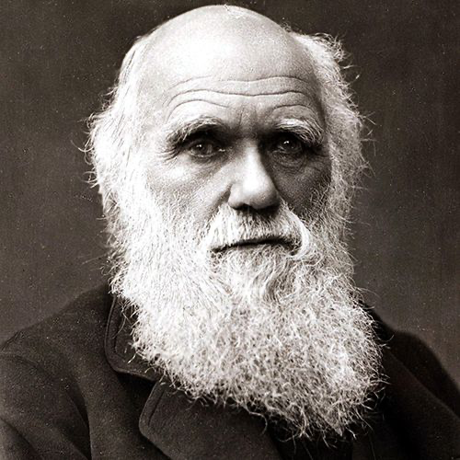

“The one most adaptable to change is the one that survives.”
Charles Darwin, naturalist, geologist and biologist

Slide 3



Today’s business climate demands agility
Evolving Technology
Generative AI is impacting all areas of the business and life in general.
Economic Pressures
High inflation and mass layoffs are forcing companies to do more with less.
Customer Expectations
Customers want immediate and personalized services and access to the latest technology.

Slide 4
However, most business strategies are not agile
Only 10%
of organizations successfully execute strategic planning.
Source: Who's Responsible for Strategic Planning? | Harvard Business School Online, Dec 2022
Only 13-16%
of organizations are highly effective at re-prioritizing work and investment to respond to change.
Source: 9 Actions SPM Leaders Must Take To Navigate Economic Headwinds | Gartner, Inc – 26 June 2023
4 out of 5
CFOs say their capital allocation process needs to be improved with better access to data.
Source: Is your capital allocation strategy a long-term plan or short-term fix? | EY – Global, Mar 2021

Slide 5
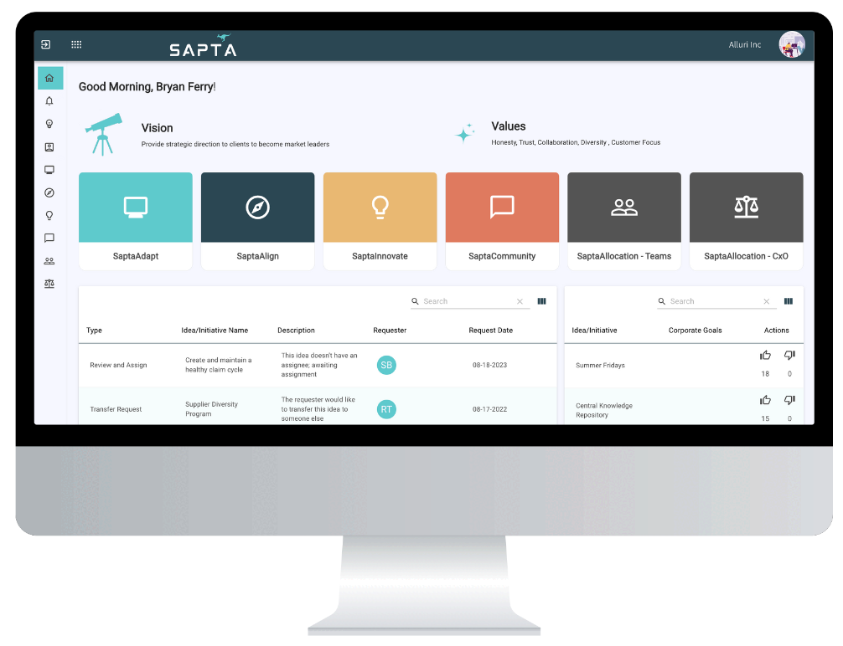
Introducing Sapta’s adaptive strategy platform
Empowering the C-Suite to quickly and confidently adapt corporate strategies to meet changing market demands:
Supercharge innovation by crowdsourcing ideas
Foster top-to-bottom and side-to-side alignment on corporate strategies
Identify & mitigate risks with real-time scenario modeling
Monitor your strategic health with a single pane of glass dashboard

Slide 6
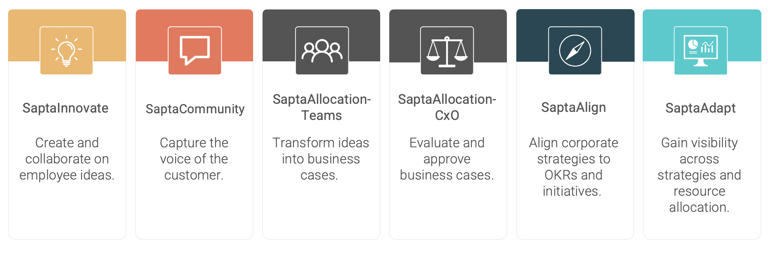
Six integrated products bring together
Open Innovation, Strategic Portfolio Management, and Capital Allocation

Slide 7
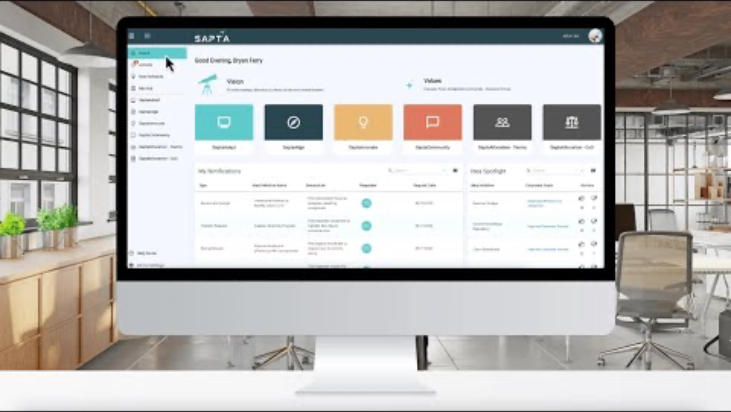
Notes:
Links to demo video in YouTube: https://www.youtube.com/watch?v=2KYv-_qBLAs&t

Slide 9
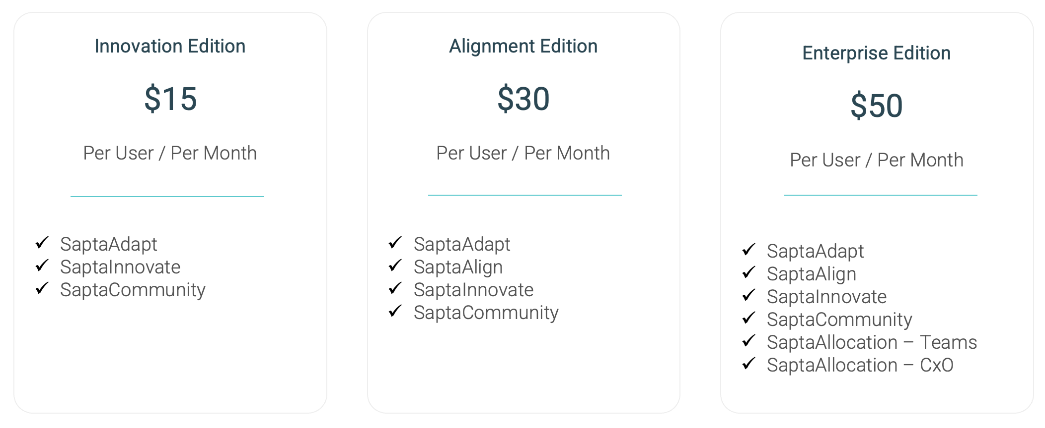
Choose the plan that fits your needs
*Incentivized pricing available for 500+ users

